Slide 1

Working with Streaming Data: Analysis of Twitter Tweets
Anand Raghuraman
Ehdieh Khaledian
EECS, Washington state university
12/5/2016

Slide 2

Context
Introduction
Twitter
Twitter Streaming API
Project
Sentiment Analysis
Result
Summary

Slide 3
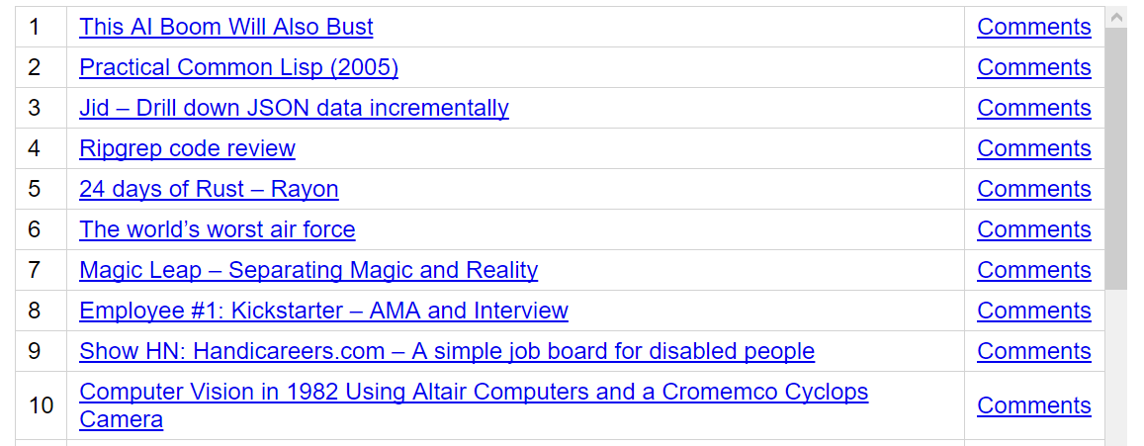

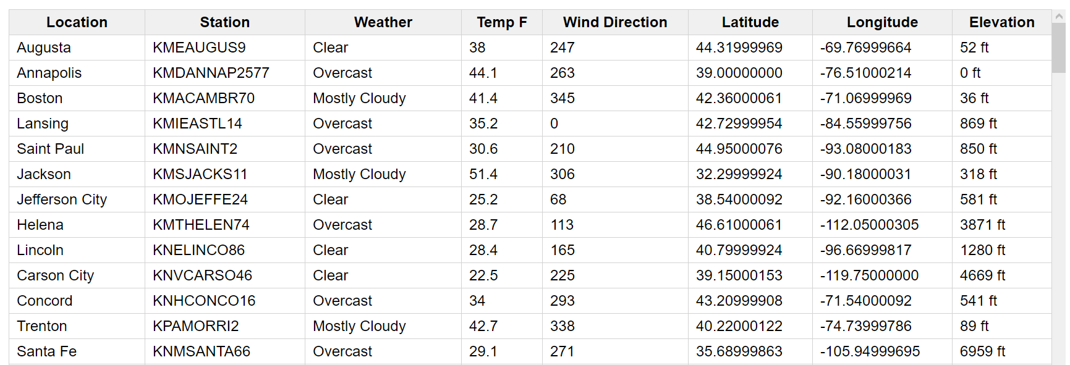
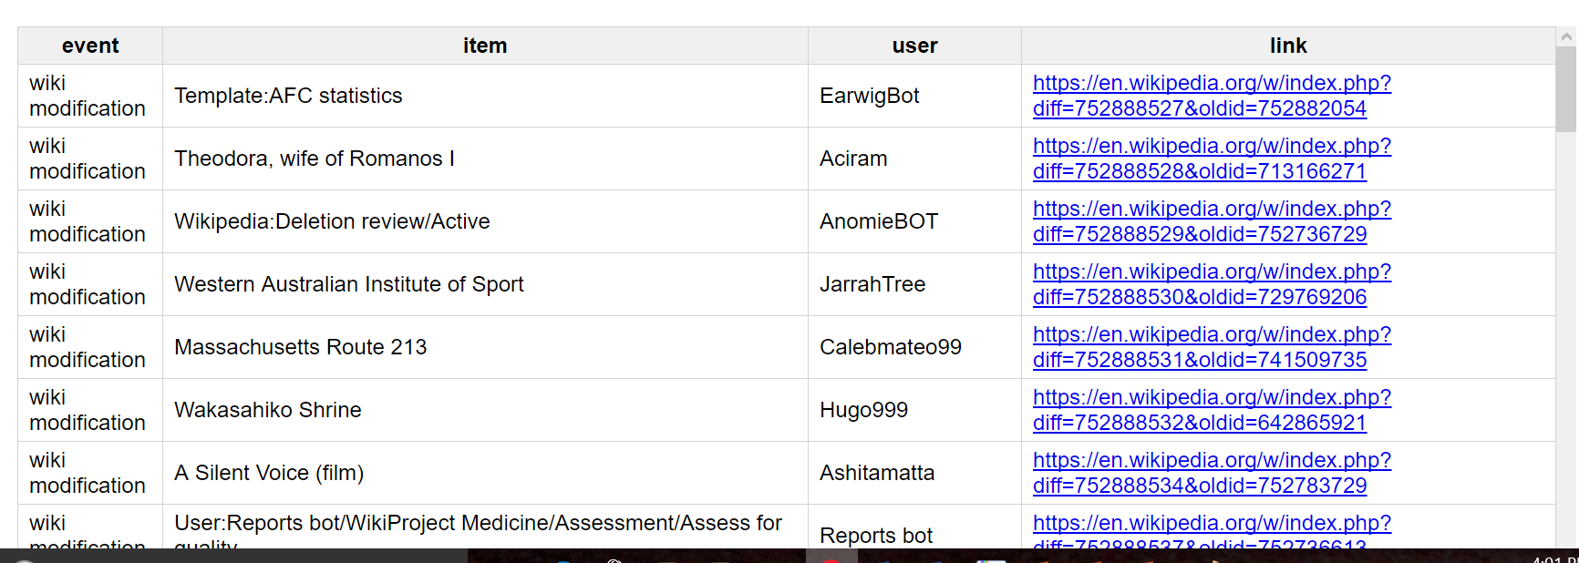
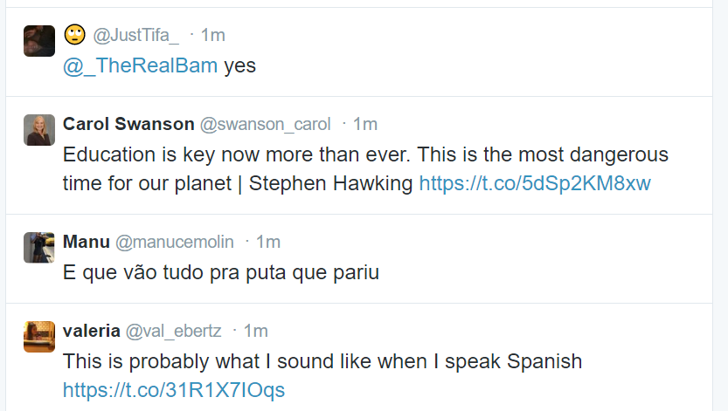
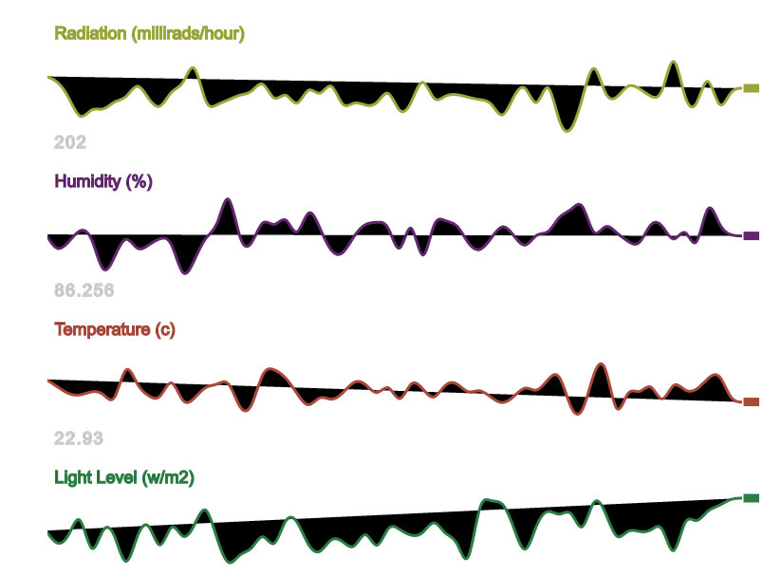
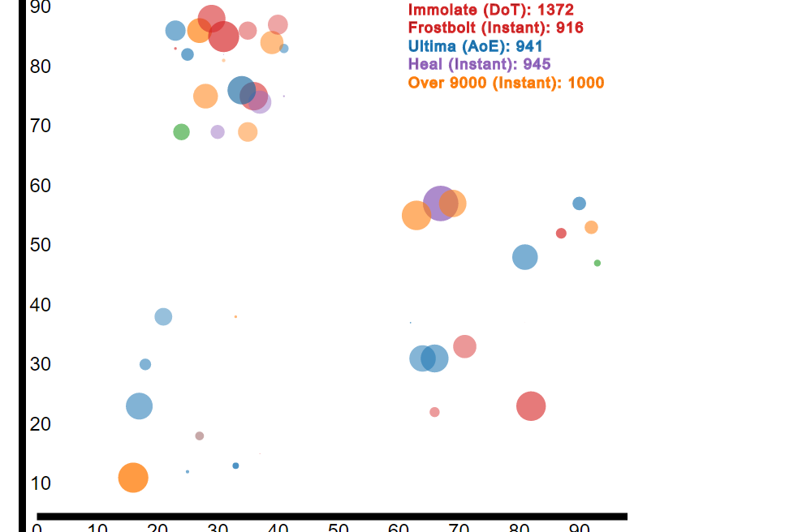
Introduction
REAL TIME DATA
Typical Data Analysis: Reading from a csv file or any other historical data
2/16

Slide 4

Twitter
350 Million Tweets/Day
140 Million Active users
>1 million application using API
3/16

Slide 5

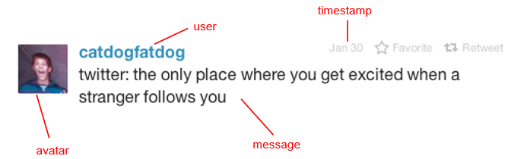
Anatomy of a tweet
What is in a tweet???
Is that all there is???
4/16

Slide 6
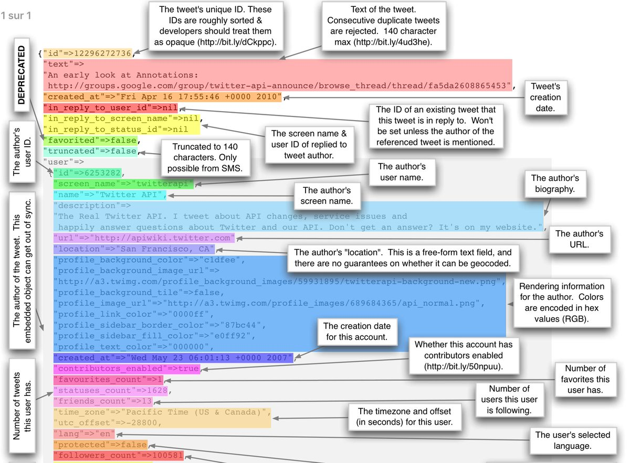
A lot more than that….
5/16

Slide 7

How do we get tweets???
REST Search API:
Search request on past data (1 week)
Streaming API:
Subscribe to real-time feeds moving forward
6/16

Slide 8


Twitter Streaming API
Retrieve the tweets in real-time (Not a csv file).
Work with streaming tweets:
Open a persistent connection to the Twitter API.
Process each tweet that we receive.
Store the processed tweets.
Twitter Streaming API:
Create a persistent connection to the Twitter API, and read each connection incrementally.
Process tweets quickly, and don’t let your program get backed up.
Handle errors and other issues properly.
7/16

Slide 9
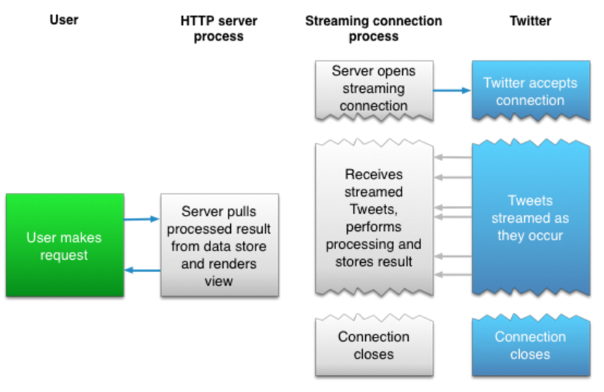
Twitter Streaming API
8/16

Slide 10


Our Project??
Fetched Tweets using Twitter Streaming API
Computed the term frequency
Used sentimental analysis to find Happiest State in US and Happiest Actor in Breaking Bad TV Series.
9/16

Slide 11



Sentiment Analysis
Sentiment
A thought, view, or attitude, especially one based mainly on emotion instead of reason
Sentiment Analysis
Aka opinion mining
Use of natural language processing (NLP) and computational techniques
to automate the extraction or classification of sentiment from typically
unstructured text
10/16

Slide 12
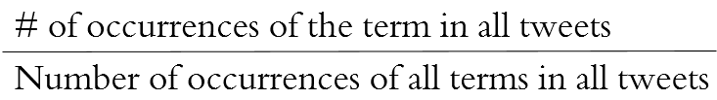

Calculating Term Frequency
Formula:
Results in the form:
[term] [Frequency]
11/16

Slide 13
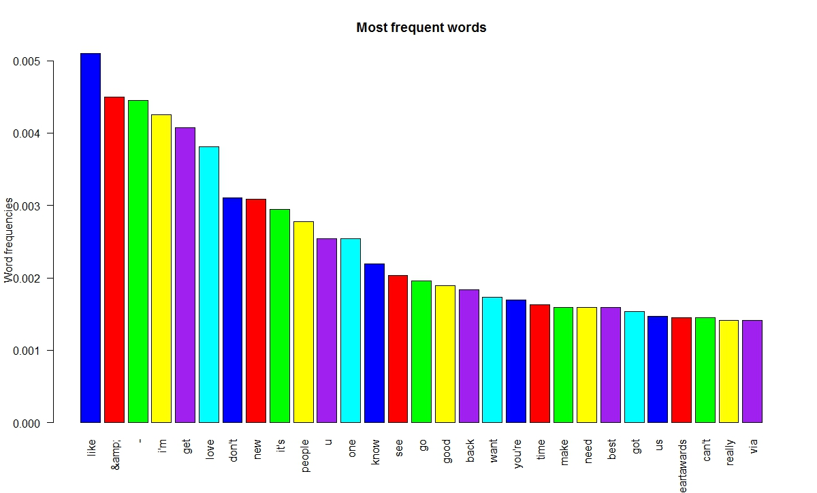
Top 30 Most frequent Words
12/16

Slide 14
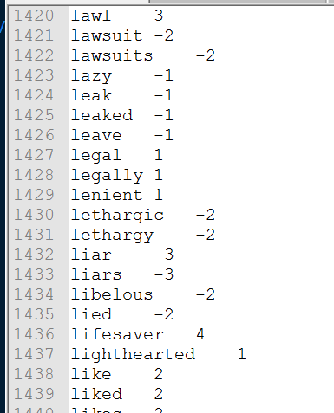
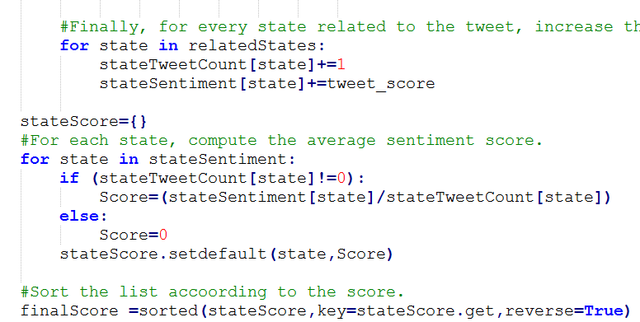
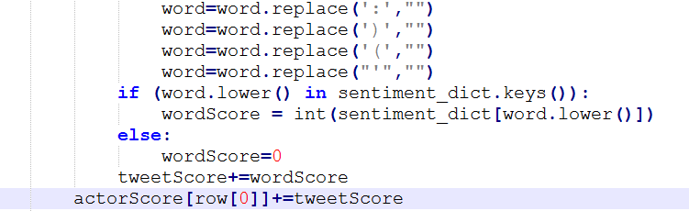
Sentiment Analysis
Computing Tweet Score
Computing Actor Score
Computing State Score
13/16

Slide 15
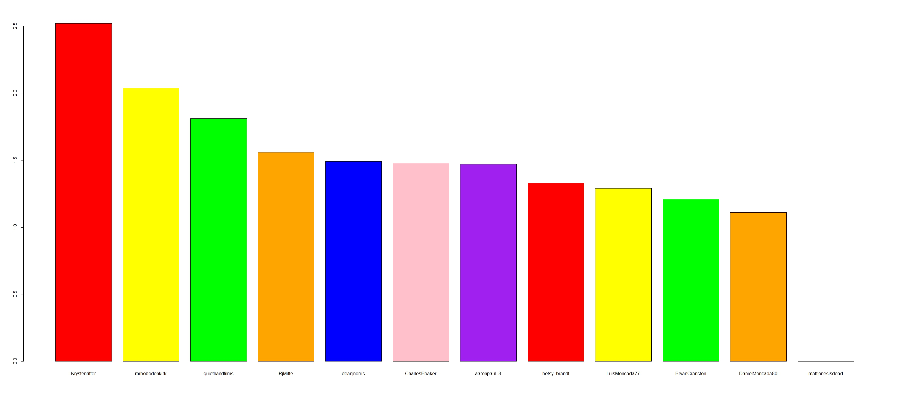
Happiest Actor of Breaking Bad
14/16

Slide 16
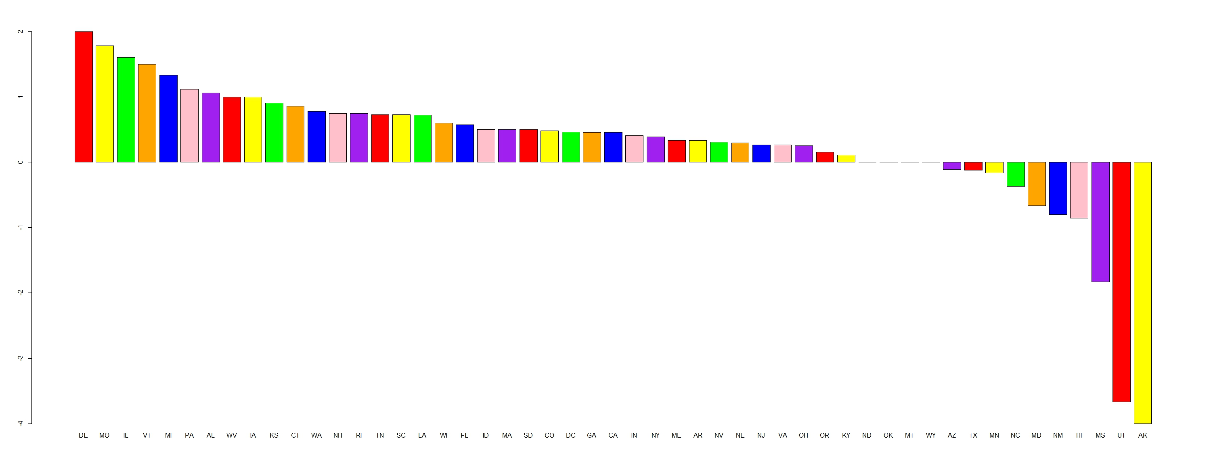
Happiest State
15/16

Slide 17
Summary
Twitter Streaming API
Sentiment Analysis
Using for various applications
Stock Market
Election Result
Human Development
16/16

Slide 18
END

